Slide 1
Young people’s social media use: Experiences of illegal and/or harmful behaviours
20 May 2026
Michelle Butler & Dirk Schubotz
Queen’s University Belfast

Slide 2
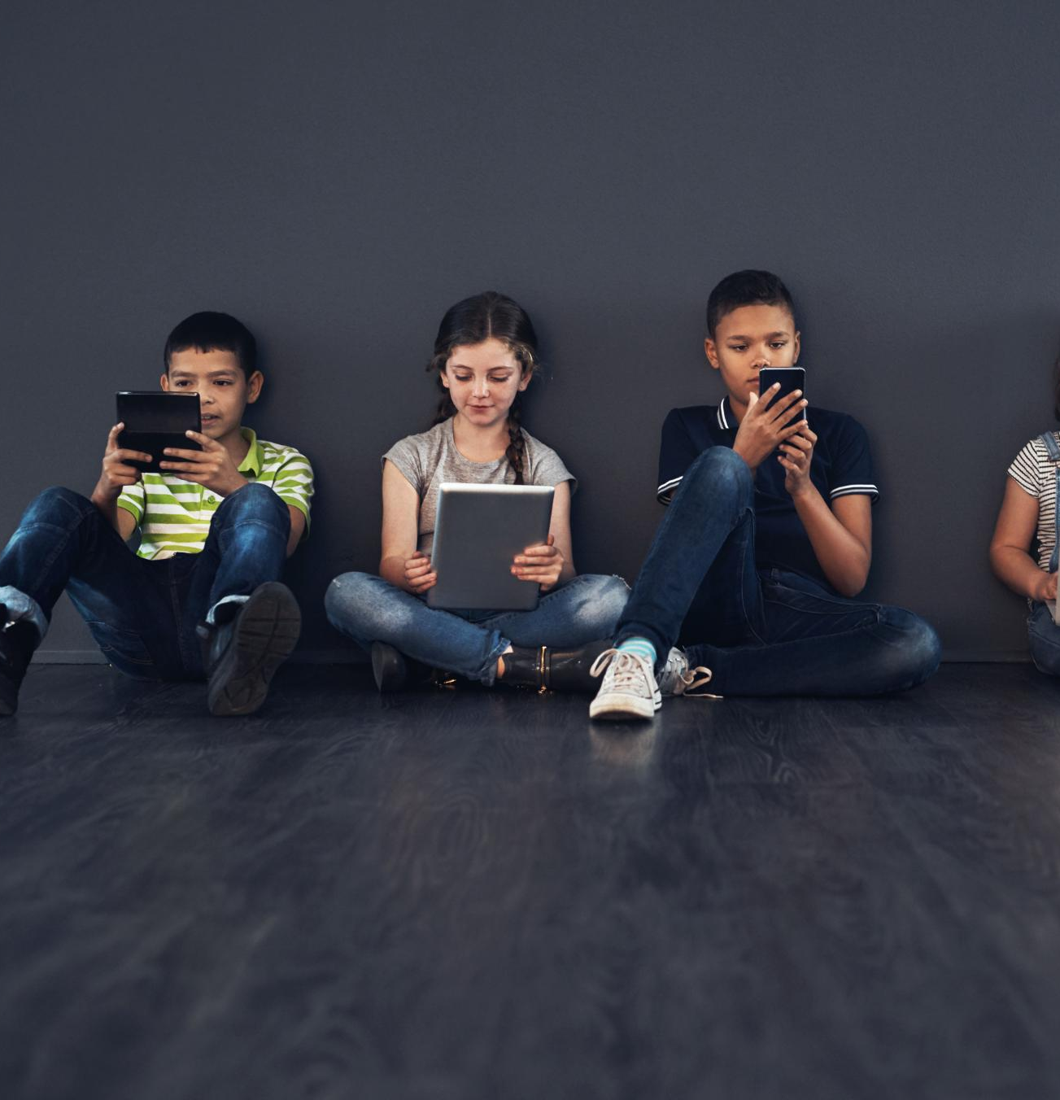
Report Overview
Focus
  Provides an in-depth look at 16-year-olds experiences of illegal and/or harmful on social media in Northern Ireland.
Evidence Base
  Draws on evidence from the Young Life and Times (YLT) 2025 survey, consisting of 2,129 16-year-olds living in Northern Ireland. This is an annual survey with a nationally representative sample of young people in Northern Ireland.
Relevance for Policy
  Offers evidence and insights to inform policy-making and interventions focused on online safety for children and young people, within frameworks like the UK Online Safety Act 2023 and Northern Ireland’s Online Safety Strategy.

Slide 3
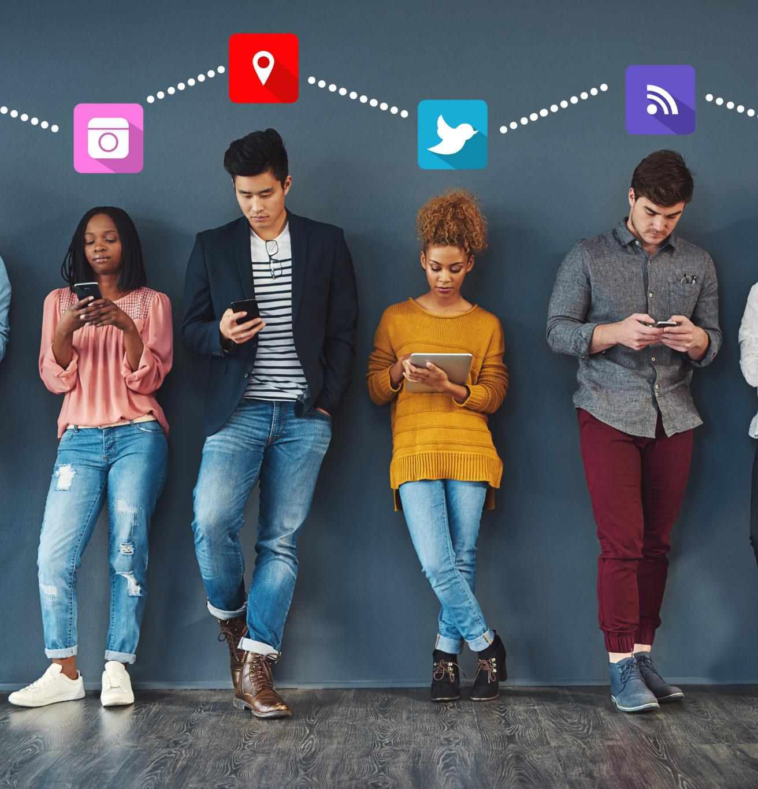
Social Media Use
Most Used Platforms
  98% of 16-year-olds used social media, with most (78%) stating they used four or more social media platforms. The most used social media platforms were: Snapchat (88%); TikTok (86%); Instagram (81%); WhatsApp (71%); and YouTube (71%).
Time Spent on Social Media
  Nearly half (46%) of 16-year-olds living n Northern Ireland reported spending between 3-5hrs on social media on an average day, with 22% spending 6-8hrs, 18% spending less than 3hrs and 8% spending more than 8hrs. Only 2% said they did not use social media.
Mental Health
  A relationship between time spent on social media with mental health and wellbeing was found. However, it is not possible to identify the causal reasons for this relationship from the 2025 YLT survey data.

Slide 4
Illegal and/or harmful behaviours experienced | %
 | Males | Females | All
Someone posting/sharing material which you found offensive, indecent or obscene | 19 | 29 | 26
Someone sharing your information, photos, videos with others without your consent | 21 | 21 | 21
Someone stalking your activities | 16 | 22 | 20
Someone attempting to build a relationship with you to try to manipulate you | 9 | 16 | 13
Someone posting/sharing material motivated by hostility/dislike towards your race, religion, sexual orientation, disability, gender | 10 | 13 | 12
Someone posting/sharing threatening, intimidation or harassing material about or towards you | 9 | 13 | 11
Offers to buy or sell illegal or stolen goods | 11 | 11 | 11
Blackmail | 8 | 10 | 9
People deliberately being dishonest to you to obtain a financial/personal benefit or cause you to lose something | 8 | 9 | 9
Someone using your information on social media to hack into your accounts | 6 | 9 | 8
Someone using your information on social media to steal your identity | 3 | 5 | 4
I have not experienced any of these behaviours | 50 | 43 | 46

Slide 5
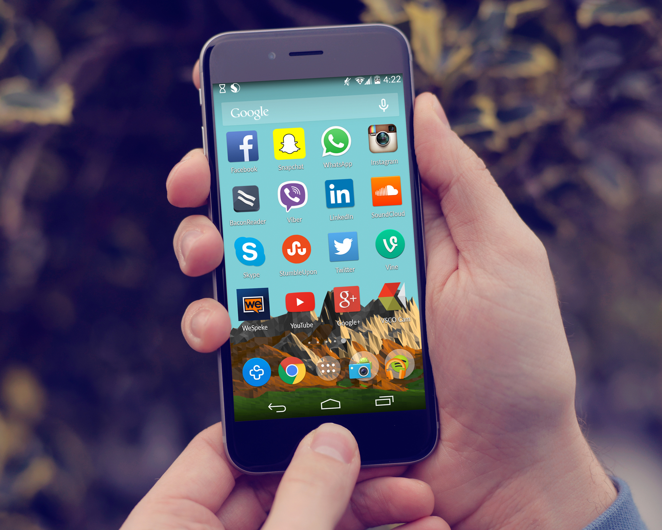
Exposure
Total Behaviours Experienced
Some groups were more likely that others to experience a greater range of illegal and/or harmful behaviours on social media. These included:
  Females
  Same-sex attracted young people
  Those reporting a disability/long-term illness
  Those coming from not well-off families
  Those living in a big city
  Those attending a Grammar school
  Those spending more than 3-5 hours per day on social media
Exposure and Mental Health
Young people believed that exposure to these types of illegal and/or harmful behaviours could negatively impact on mental health, beliefs and self-image.

Slide 6
“Social media in my opinion is very manipulative and younger people who have access to it are believing so much stuff that is completely wrong, e.g. videos created with certain topics, body issues and bullying people into looking a certain way to attract other people. It is making more people develop mental health issues, like depression and anxiety, with a sense of not feeling good enough for anyone. Or even eating disorders in which people may starve themselves because they think they are too overweight, or people eating too much because they feel too thin. Bullying people because of the way they look is never acceptable, people feel like others have to be a certain size or have certain features to be worthy of being seen as a human to them. It’s unreal.”

Slide 7
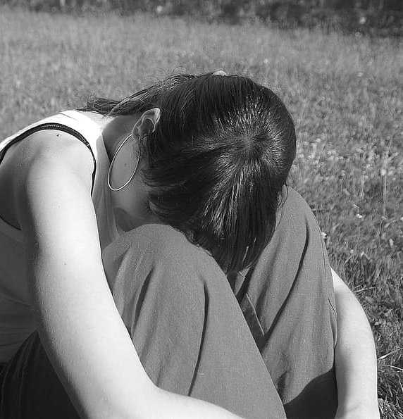
Impact
Certain experiences of illegal and/or harmful behaviours were strongly linked to poorer mental health:
Attempts to build a relationship to try to manipulate.
Posting/sharing threatening, intimidating or harassing material about/towards you.
Posting/sharing material motivated by hostility/dislike towards your race, religion, sexual orientation, disability, gender.
Someone stalking your activities.

Slide 8
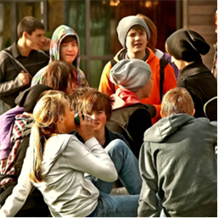

Perpetrators
Strangers and Peers
Young people were asked who had perpetrated the illegal and/or harmful behaviours they had experienced. Multiple perpetrators could be identified. While 42% identified the perpetrator as stranger, 67% said the perpetrator was known to them in their communities, with 63% identifying other young people as the perpetrators.
Likelihood of Perpetration
Notably, young people believed that other young people would be 'very likely' or 'quite likely' to engage in illegal and/or harmful behaviours on social media.
‘Normal’, ‘Fun’ or ‘Banter’
Despite being taught about online safety, some felt more attention needed to be paid to teaching young people about their own actions could cause harm and tackle perceptions that engaging in such behaviours was 'normal', 'fun' or 'banter'.

Slide 9
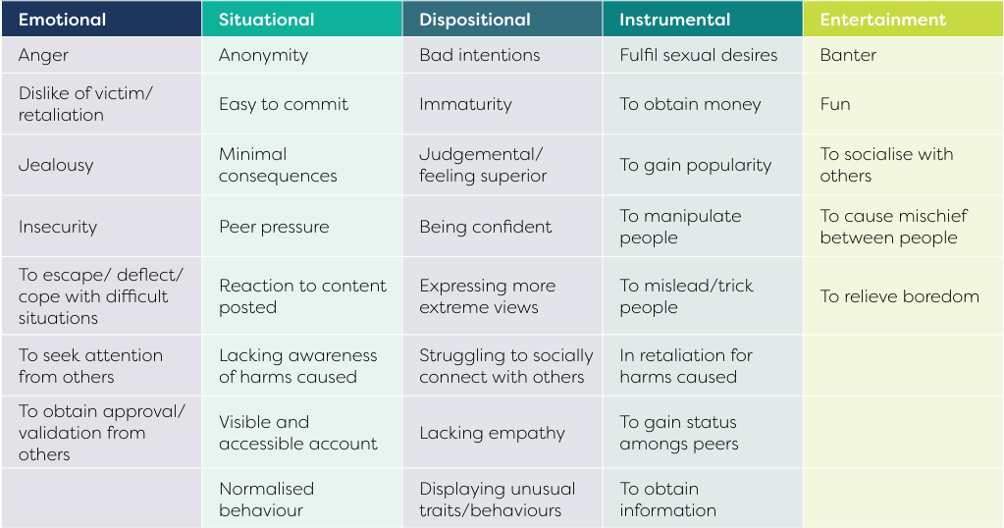
Common Explanations Given For Perpetration

Slide 10

Platforms
Platform Variation
  While all respondents felt that these behaviours could occur on any platform, 76% felt they occurred on some platforms more than others due to their popularity, user profile and features.
  Platform Features
  Such behaviours were perceived as being more likely to occur on platforms which:
  facilitated anonymity
  had less rules and moderation of content
  inadequate enforcement of policies
  where fake accounts could be easily created
  where content was encrypted
  user accounts are publicly visible, searchable and easily accessible
  where direct communication with other is enabled
  where users can control who views their content
  content can be automatically deleted (e.g. Snapchat).

Slide 11
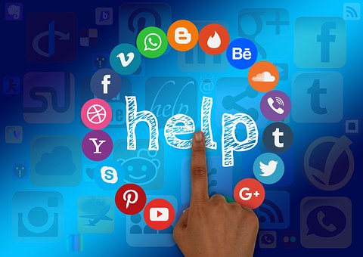
Support
Perceived Competency
  While 49% felt young people were ‘very’ or ‘quite’ competent to deal with illegal and/or harmful behaviours on social media, 32% felt they were ‘not very’ or ‘not at all competent’ to deal with these behaviours.
  More Work Needed
  Some felt that more work needed to be done to teach young people how to behave appropriately on social media, focusing especially on how their own actions may harm others and tackling perceptions such behaviours are ‘normal’, ‘fun’ or ‘banter’.

Slide 12
Recommendations
More awareness raising and education in schools and at home.
Need for more research and greater recognition of how social media experiences may affect mental health and wellbeing.
Better reporting mechanisms and stricter sanctions for perpetrators of illegal and/or harmful behaviours on social media.
Implementation, regulation and enforcement of the UK Online Safety Act 2023.
Monitoring of research into adaptive AI-generated algorithms.

Slide 13
Contact Details
Michelle Butler: michelle.butler@qub.ac.uk
Dirk Schubotz: d.schubotz@qub.ac.uk

