Slide 1
The cyber-victimisation of disabled adults in Northern Ireland
Dr Zhraa Alhaboby
The Open University
Zhraa.Alhaboby@Open.ac.uk

Slide 2
Introduction
Cyber-victimisation as a research area.
Cyber-victimisation of disabled people in Northern Ireland.
The role of public health emergencies.
Policy context and points for consideration.
Are online harms affecting disabled people in Northern Ireland fully recognised within current frameworks, referrals and support systems?

Slide 3
What is cyber-victimisation?
Repeated harmful online behaviour including harassment, insults. threats, spreading misinformation.
Umbrella term.
Previous research showed differences in terminology used when the targeted person is disabled.
Targeting by individuals or groups.

Slide 4
Why this matters
1 in 5 people in Northern Ireland is disabled.
Disability hate crime reached highest recorded level in 2022/23.
Digital spaces are essential for healthcare access, social support, and daily life for many disabled people.
These same spaces expose individuals to sustained harassment, abuse, and discrimination
Logging off is often not an option, making exposure unavoidable.
This creates a hidden but significant risk to health, access and participation.

Slide 5
Methodology
Mixed-method research (survey and interviews)
Recruitment: via collaborators and a social media campaign (2,251 engagements)
Data were collected between April and November 2024.
Theoretical framework
The mixed-methods approach enabled both an assessment of the prevalence and characteristics of cyber-victimisation, and deeper insight into participants’ lived experiences.
The research was funded by The British Academy
In collaboration with Victim Support NI and the Hate Crime Advocacy Service
Ethics review reference (HREC 0119)

Slide 6
Scope of the issue in Northern Ireland
113 survey participants and 17 qualitative participants
A high percentage (30.1%) experienced online harassment, 23.1% specifically during the pandemic.
Among those targeted, 20% reported extreme fear, 23.3% moderate fear.
The duration of harassment varied, with 27.6% experiencing it for less than two weeks, and 20.7% for three months to one year.
56.25% believed it was motivated by hate.
20% were still being harassed.

Slide 7
Public health impact
44%
reported disruption
to managing their health
Missed appointments and reduced engagement with healthcare services.
Changes to medication routines and self-management practices.
Increased stress triggering flare-ups of existing conditions.
Health complications lead to implications on health systems.
Link to previous research with healthcare professionals.

Slide 8
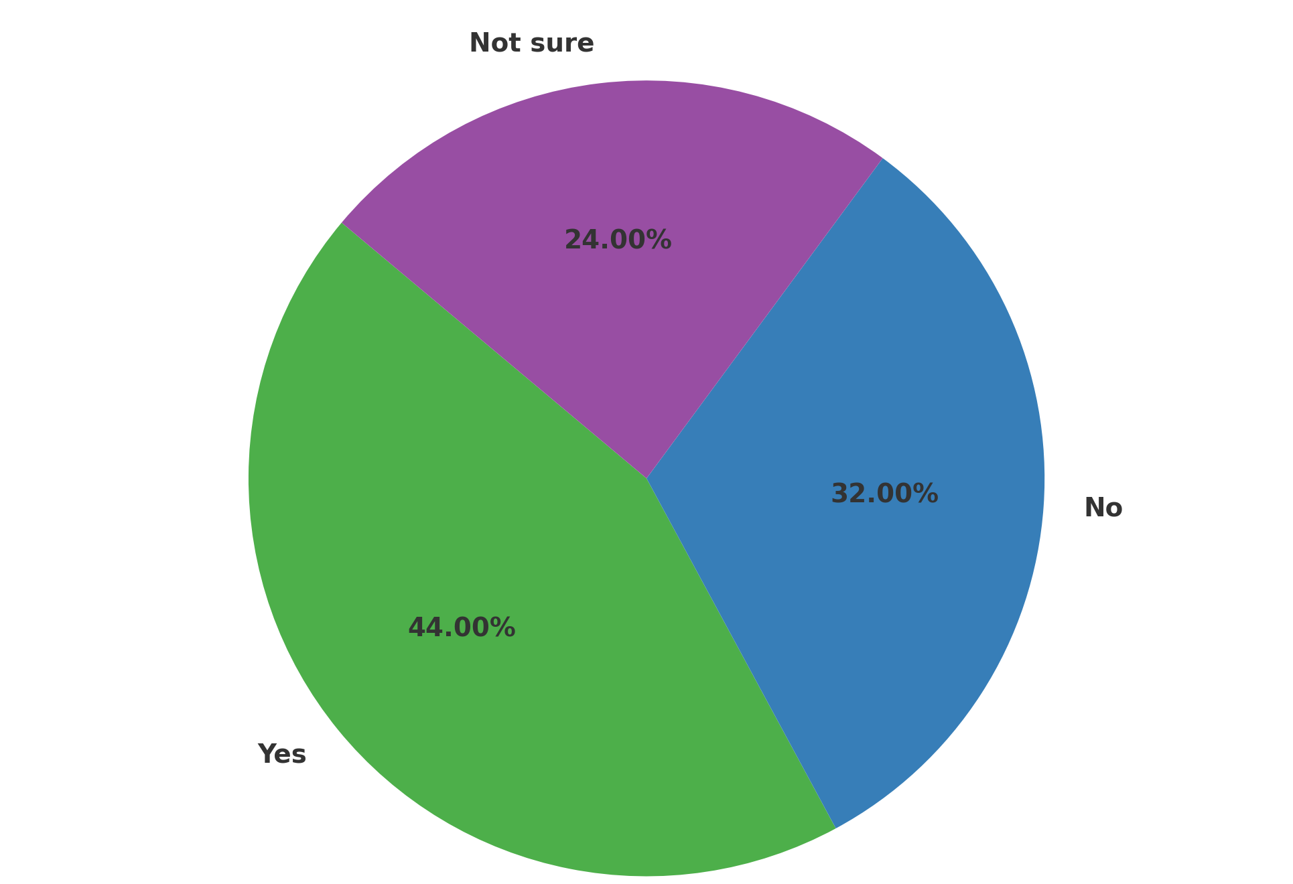

The impact of cyber-victimisation on health and self-management

Slide 9
Impact goes beyond the screen
Cyber-victimisation affects physical health, mental and social wellbeing.
Participants reported anxiety, fear, and trauma-like experiences.
Impacts extend into family life and daily functioning.
Withdrawal from online spaces, services, and social networks.
Experiences of public attitudes and victim-blaming.
Public health emergencies and public health messaging.
Calls for help and the need for coordinated approaches and interventions.

Slide 10
Participant’s voice
“Increased my anxiety and pain medication. Binge eating led to further obesity. Compounded my PTSD.” Participant 2

Slide 11
Support gap
0%
Reported cyber-victimisation
to police.
“Lack of public information and not being treated seriously by police” Participant 9
Issues of trust in formal systems.
Concerns about victim-blaming and disbelief.

Slide 12
UK research and Northern Ireland context
Comparison to previous research by the team in England and Scotland.
Smaller population increases visibility. Participants reported feeling more exposed, identifiable and less protected when facing hostile public attitudes.
Health information and political views were used alongside disability-related targeting.
Experiences during the COVID-19 pandemic (hostility, vaccination and medical exemption)

Slide 13
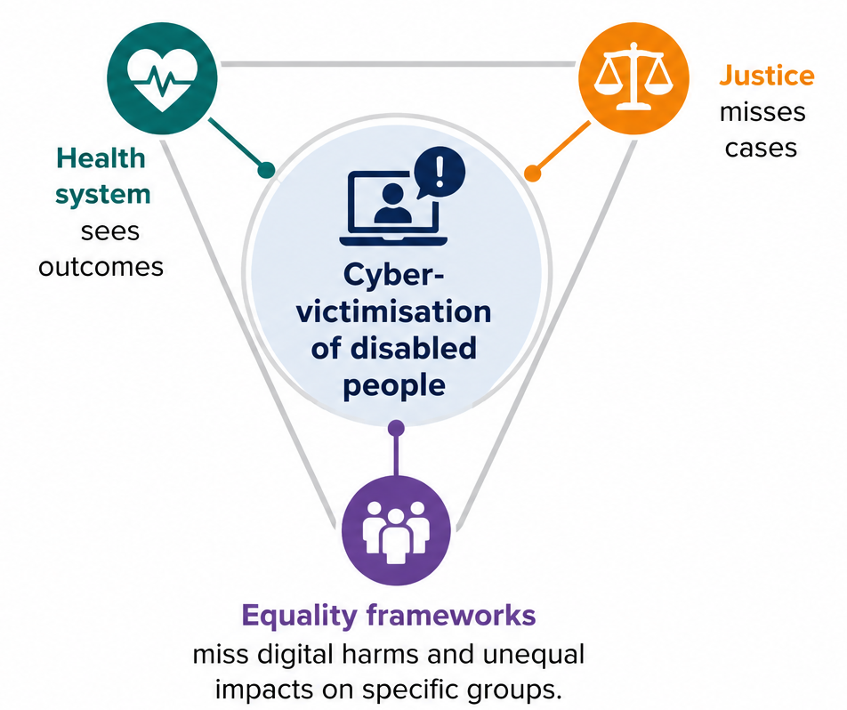
Why this matters for policymakers
Risk of policy not fully addressing real-world experiences.
This results in a fragmented response across systems.

Slide 14
Policy relevance
Victims and Witnesses of Crime Bill aims to improve victim experience.
Section 75 requires consideration of differential impacts on disabled people.
Disability Strategy 2025–2035 promotes inclusion and participation.
Cyber-victimisation of this group intersects all three but is not fully recognised.

Slide 15
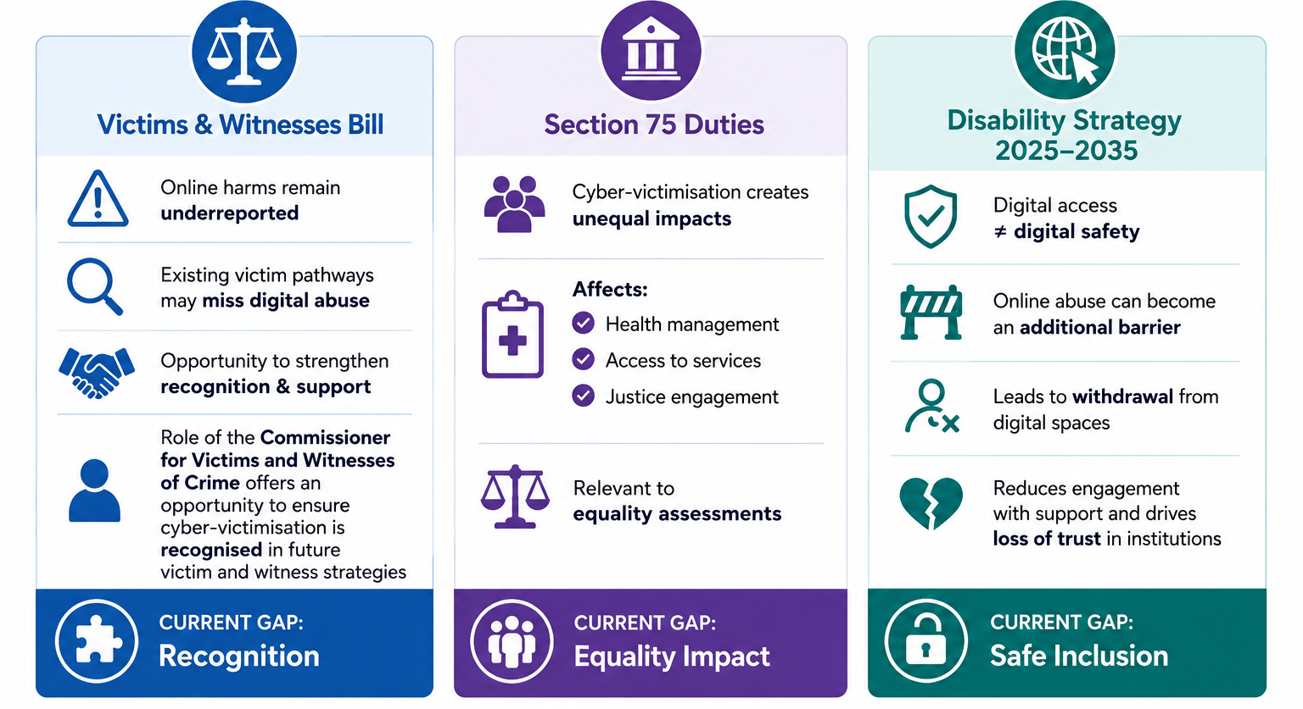
Policy considerations:
Cyber-victimisation of disabled people

Slide 16
Closing
Cyber-victimisation of disabled people in Northern Ireland is prevalent, harmful and under-recognised.
The research raises important considerations across health, justice and equality.
Cyber-victimisation can function as a digital determinant of health and a human rights issue, pointing to the need for coordinated approaches to improve recognition, and pathways for referral and support.

